Slide 1
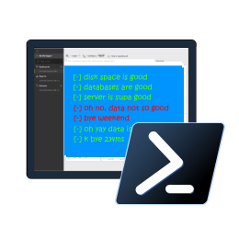

Reliable, Repeatable, Configurable & Automated Validation with
PowerShell dbachecks
Rob Sewell @sqldbawithbeard https://sqldbawithAbeard.com

Slide 2
Speaker Questionnaire
Name : Rob
Occupation : DBA, Automator, Do-er, Trainer
Interests : PowerShell, Automation And SQL (PaaS geddit?)
Interesting Fact : Beard. (Still) Plays Cricket, Flies Drone
Speaker : SQL Saturdays, SQL Relay, PowerShell Events
Community : SQL South West , SQL Sat Exeter , PowerShell VG, PowerShell Conference EU Organiser, dbareports, dbatools, dbachecks, MVP

Slide 3
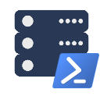





Contact Me
Quick Poll
@sqldbawithbeard
robsewellsqldba
sqldbawithAbeard.com
mrrobsewell@outlook.com
RobSewell.info

Slide 4


Check Lists
Photo by Glenn Carstens-Peters on Unsplash

Slide 5
What is Pester?
Test Runner for PowerShell
A Unit Testing Framework
An Infrastructure Testing Framework
https://github.com/pester
Notes:
https://www.youtube.com/watch?v=lNCR5yLSwi0 -- Test your Powershell with Pester and PSScriptAnalyzer
“Untested Code is Broken Code”
Infrastructure Testing with Pester - https://www.youtube.com/watch?v=zSEK74_fsLw
Pester is a unit-testing framework for PowerShell, and perhaps the first open-source software product that ships with Windows itself!
Author Adam Bertram will walk you through the Pester philosophy, syntax, and numerous real-world examples in this "Agile-published" book.
The Pester Book
https://leanpub.com/creatinghtmlreportsinwindowspowershell
https://leanpub.com/powershell-scripting-toolmaking
https://leanpub.com/pesterbook

Slide 6
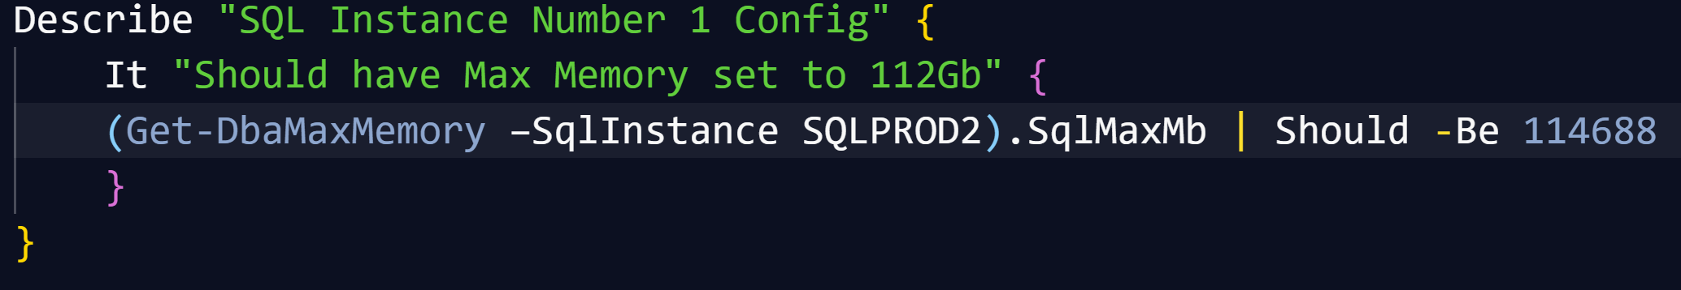
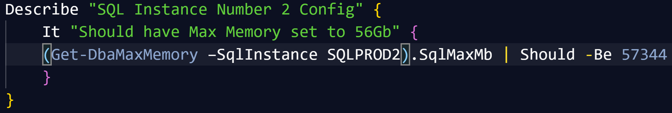
Pester
Writing Pester Tests for one SQL instance is easy once you “get” Pester
Writing slightly different Pester Tests for slightly different instances is copy and paste

Slide 7
Pester
Writing slightly different Pester Tests for slightly different instances is copy and paste
It is possible to parameterize Pester tests (but not so easy to say!)

Slide 8

Challenges & Goals

Slide 9
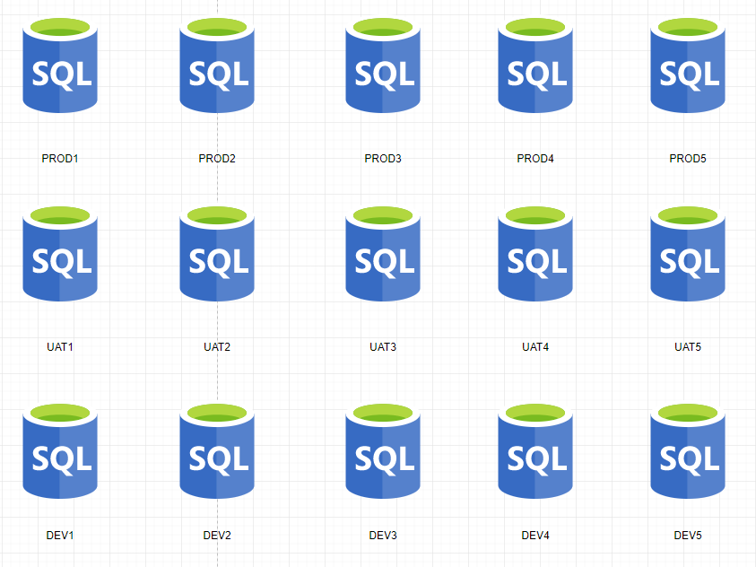
Consider Your SQL Environment

Slide 10
Consider Your SQL Environment
PRODUCTION
No SA account
Backup Compression
FULL Recovery
Secure Backup Location
Agent Alerts
Production Agent Jobs
Only Certain Production AD Groups allowed
And much more

Slide 11
Consider Your SQL Environment
TEST
Different Backup Strategy
Test Agent Jobs
Needs the Testers AD Groups
And much more

Slide 12
Consider Your SQL Environment
Development
Simple Recovery
No Agent Jobs
Definitely no Production AD Information
SA Account
And much more

Slide 13
Consider Your SQL Environment
Widget One
Global view of one ‘widgets’ environments might be needed for
Project Managers
Team Leaders
Release Managers
Agile Teams

Slide 14

Consider Your SQL Environment
Special Snowflakes
For those ‘special’ SQL Servers that don’t fit in the usual boxes
I.E. SharePoint

Slide 15
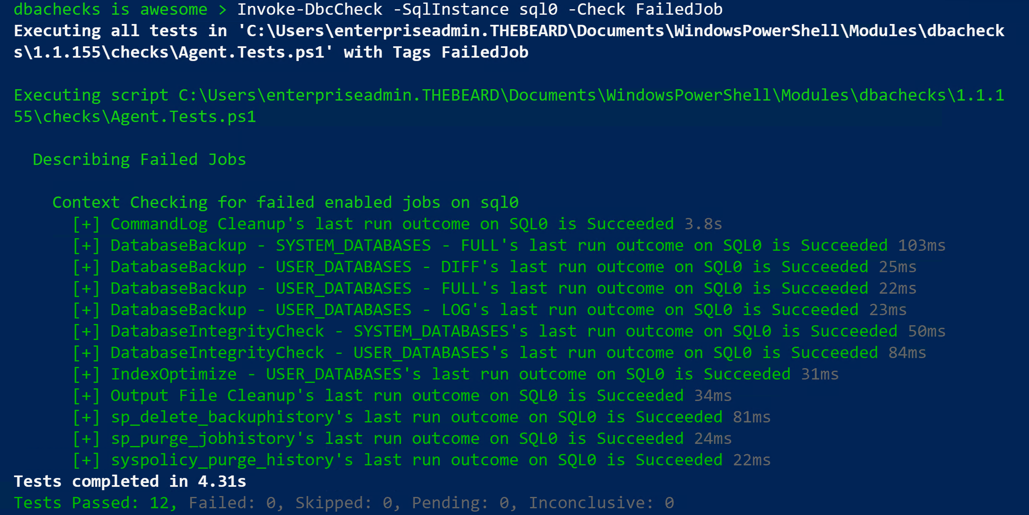
Challenge - Output
DBAs may need output instantly

Slide 16
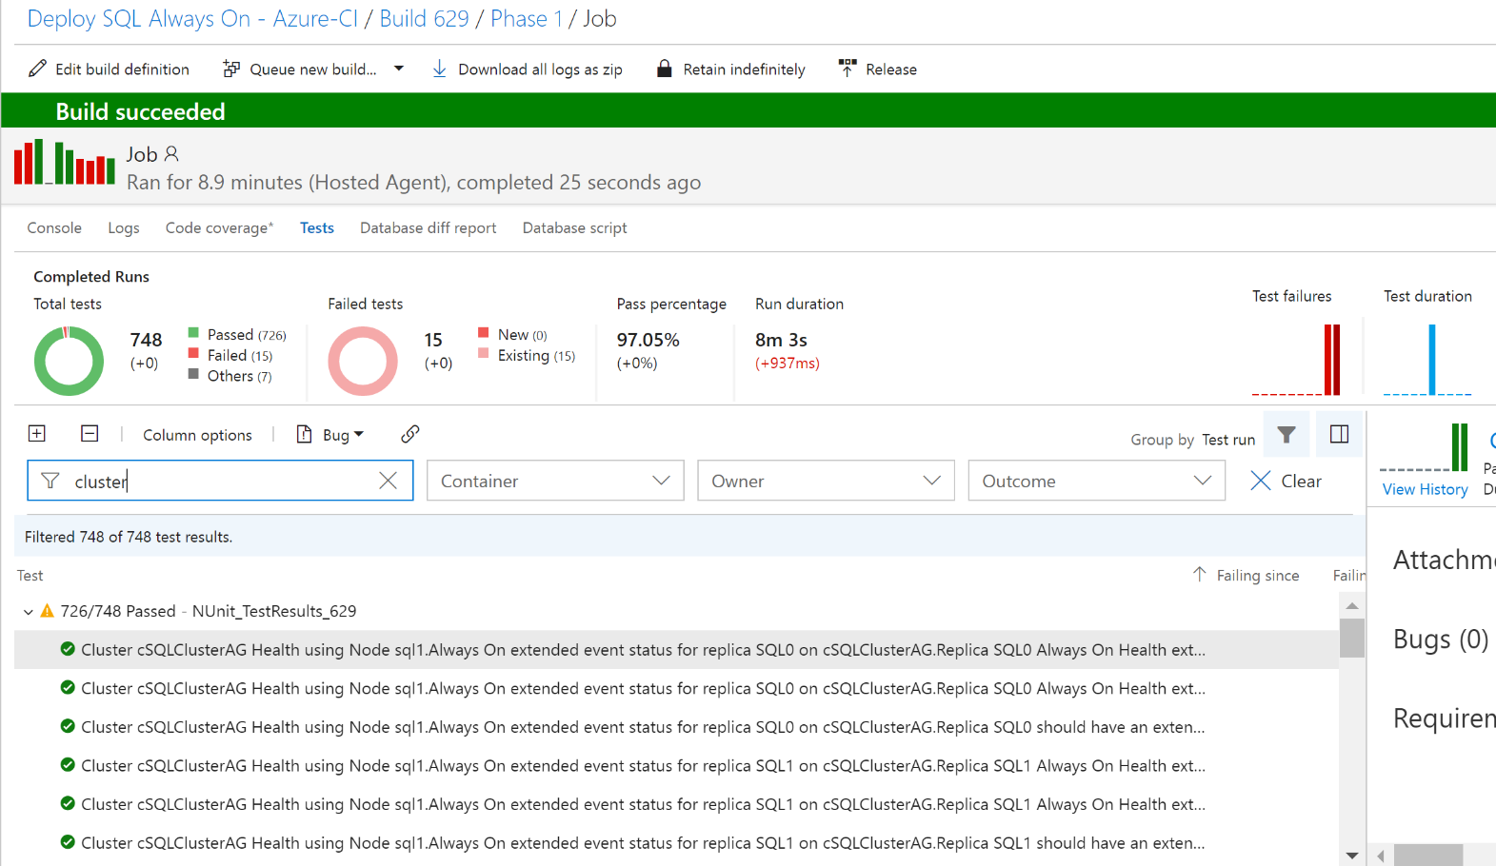
Challenge - Output
DBAs may want to automate and integrate with other solutions (DevOps, Daily Checks, Incident Response, Maintenance Windows)

Slide 17
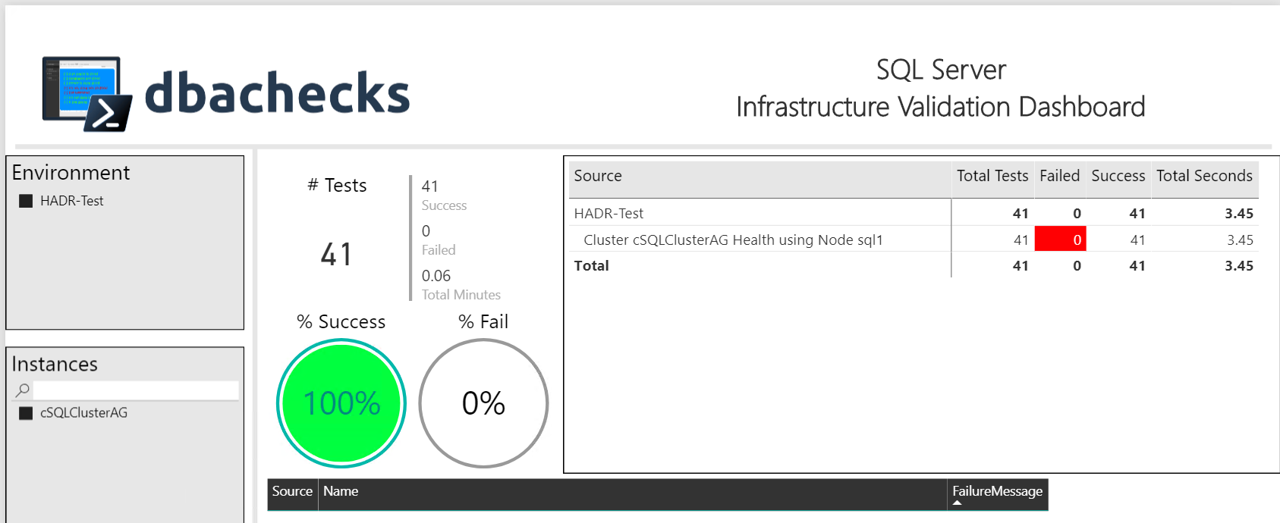
Challenge - Output
Management want output they understand
– (and with pretty interactive pictures !)

Slide 18
Our Goal
Create redistributable, easily configurable Pester tests using industry leaders checklists
Enable output to suit the requirements of different types of end users human and machine

Slide 19
System Requirements
Recommended
Minimum
Client
PowerShell v4
Modules
dbatools
Pester
PSFramework
Client
PowerShell v5.1
Server
Everything dbatools supports
From SQL2000 to SQL vNext

Slide 20
Installation is easy
PowerShell Gallery
Install-Module dbachecks
Install-Module dbachecks –Scope CurrentUser
* Automatically installs required modules

Slide 21
Need an offline install?
Save-Module dbachecks, dbatools, Pester, PSFramework

Slide 22
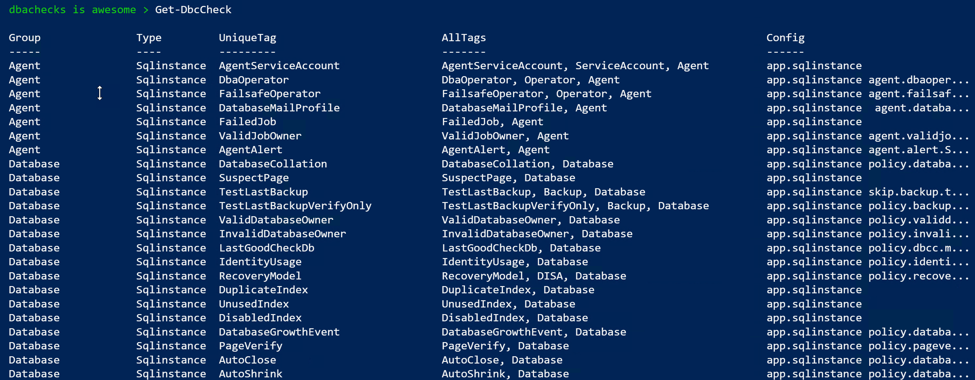
What Checks Are Available? Use Get-DbcCheck
PowerShell > Get-DbcCheck

Slide 23
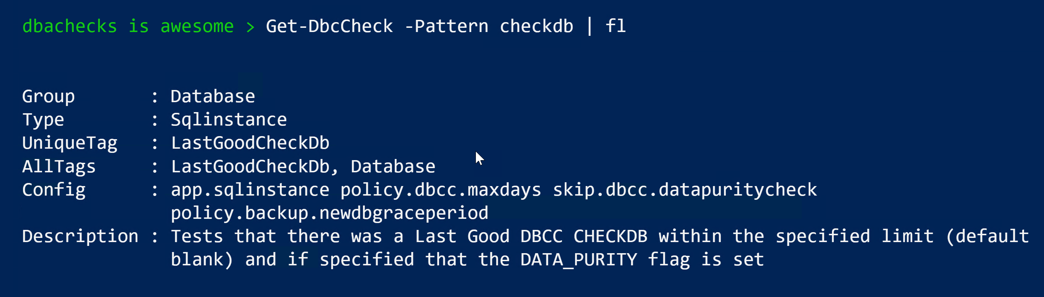
What Checks Are Available? Use Get-DbcCheck

Slide 24
What Checks Are Available? Use Get-DbcCheck

Slide 25
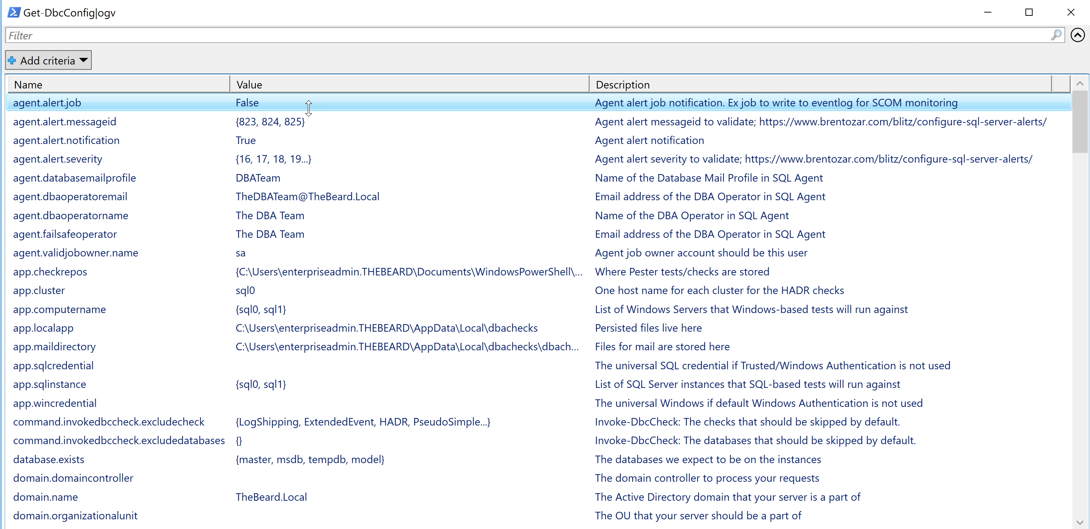
What Configs Are Available? Use Get-DbcConfig
PowerShell > Get-DbcConfig

Slide 26
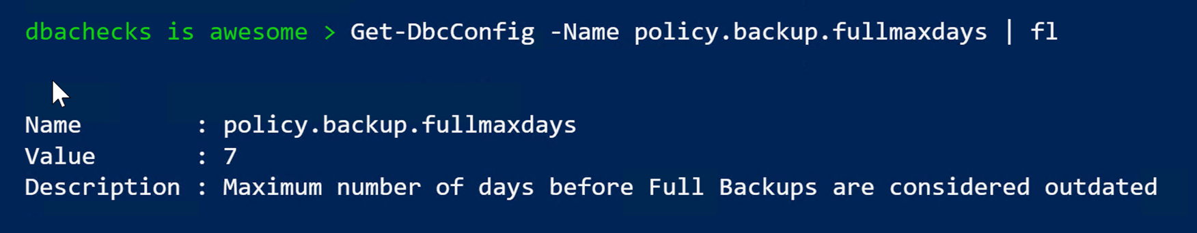
What Configs Are Available? Use Get-DbcConfig

Slide 27
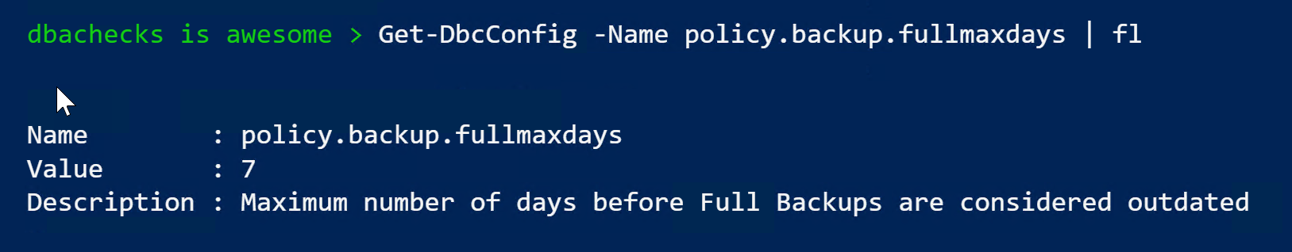
What Configs Are Available? Use Get-DbcConfig

Slide 28
How Do I Run A Check?
PowerShell > Invoke-DbcCheck –SqlInstance ROB-XPS –Check FailedJob

Slide 29
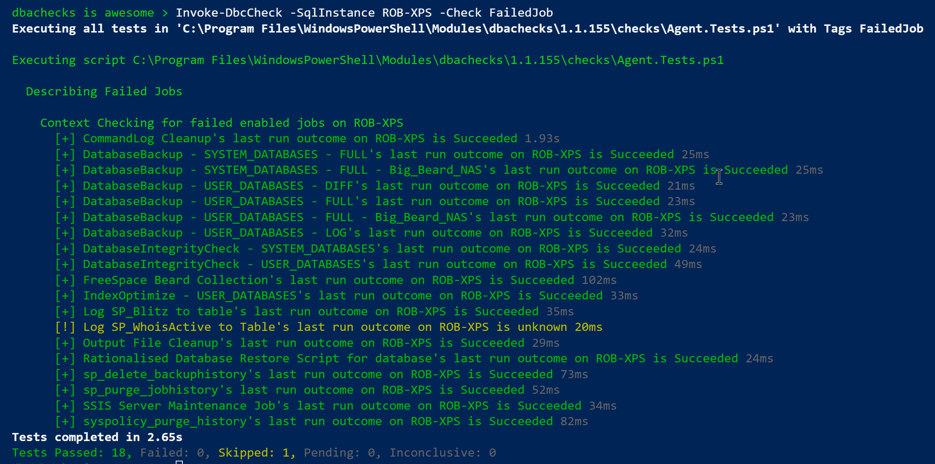
Invoke-DbcCheck – Run A Check

Slide 30
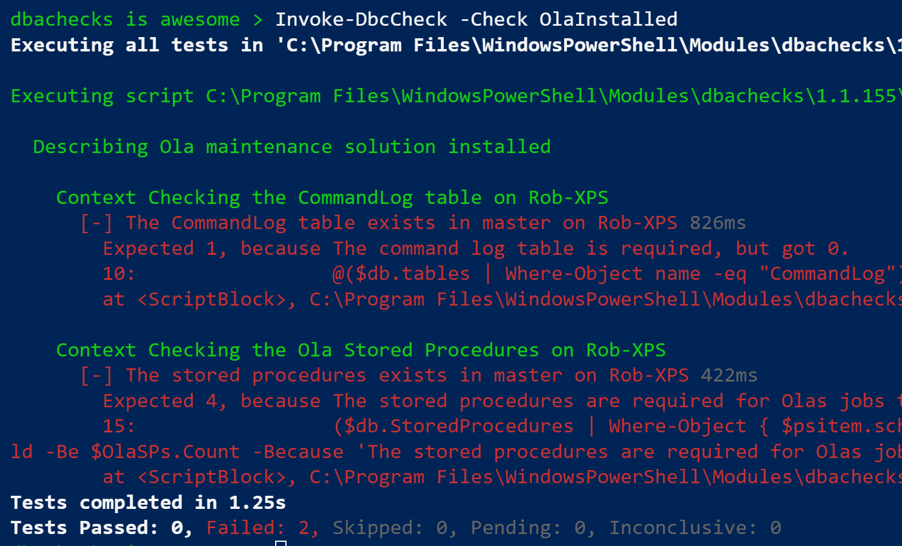
Configurations?
> # Set the instances to check
> Set-DbcConfig -Name app.sqlinstance Rob-XPS
> Invoke-DbcCheck -Check OlaInstalled

Slide 31
Configurations?
I don’t have Ola installed in the default database (master)
> Set-DbcConfig -Name policy.ola.database -Value DBA-Admin
> Invoke-DbcCheck -Check OlaInstalled

Slide 32
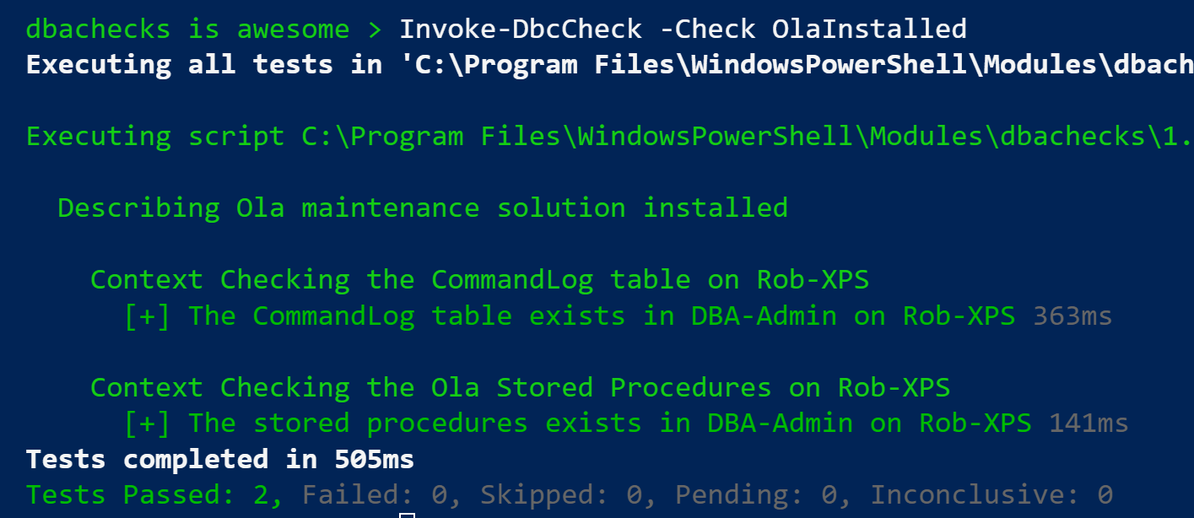
Configurations?
I don’t have Ola installed in the default database (master)
> Set-DbcConfig -Name policy.ola.database -Value DBA-Admin
> Invoke-DbcCheck -Check OlaInstalled

Slide 33
Configurations?

Slide 34
Export-DbcConfig/Import-DbcConfig
Export-DbcConfig –Path C:\Users\Beard\git\PesterConfigs\Application1_PROD.json
Export-DbcConfig -Path C:\Users\Hair\git\PesterConfigs\Client1_System2_Quick.json
Import-DbcConfig -Path Git:\PesterConfigs\Application1_PROD.json
Invoke-DbcCheck
Import-DbcConfig -Path Git:\PesterConfigs\Client1_System2_Quick.json
Invoke-DbcCheck

Slide 35
Start-DbcPowerBi
Import-DbcConfig –path Git:\PesterConfigs\App1_Dev.json
Invoke-DbcCheck -Show Summary -PassThru | Update-DbcPowerBiDataSource –Environment Development
Import-DbcConfig –path Git:\PesterConfigs\App1_Test.json
Invoke-DbcCheck -Show Summary -PassThru | Update-DbcPowerBiDataSource –Environment Test
Import-DbcConfig –path Git:\PesterConfigs\App1_PROD.json
Invoke-DbcCheck -Show Summary -PassThru | Update-DbcPowerBiDataSource –Environment Production
Start-DbcPowerbi

Slide 36
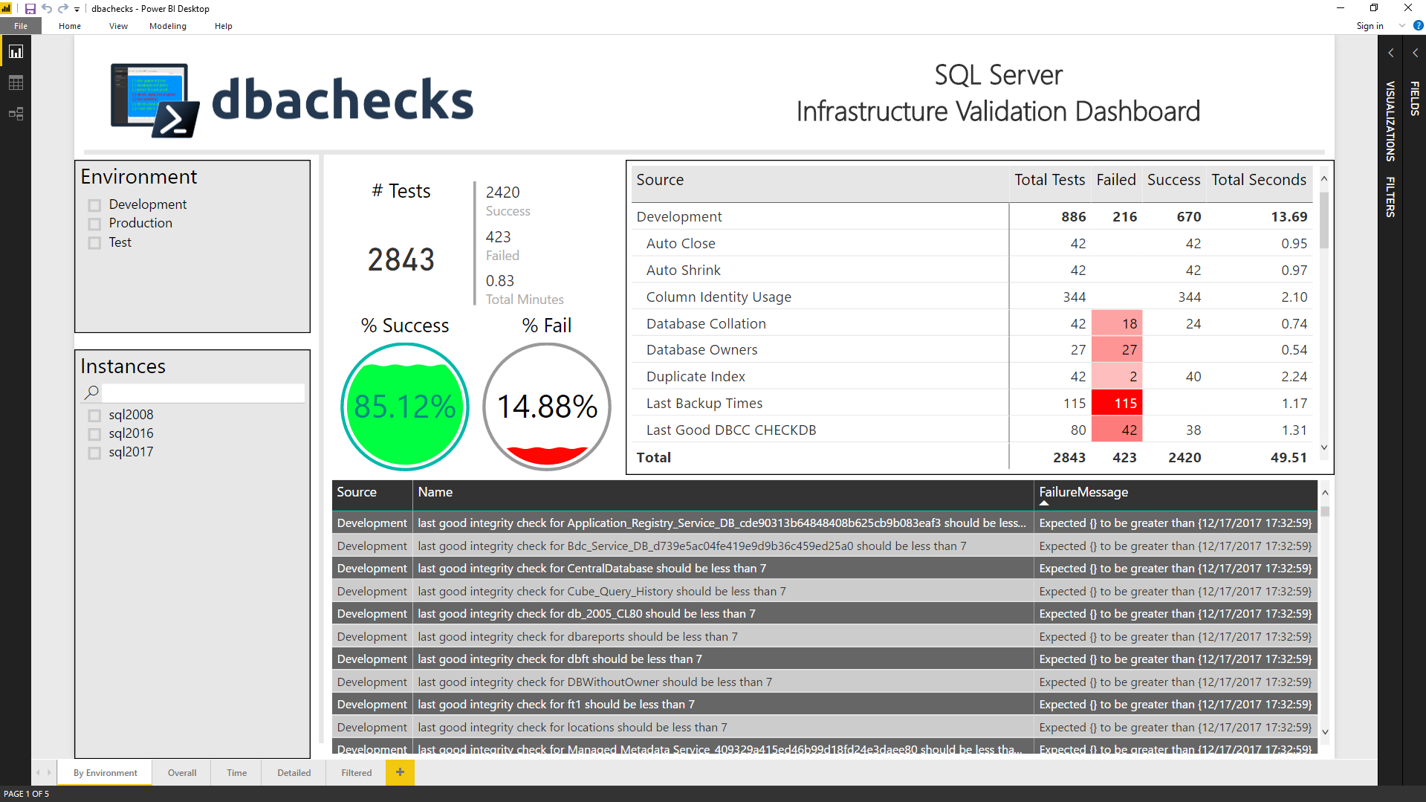
Start-DbcPowerBi

Slide 37
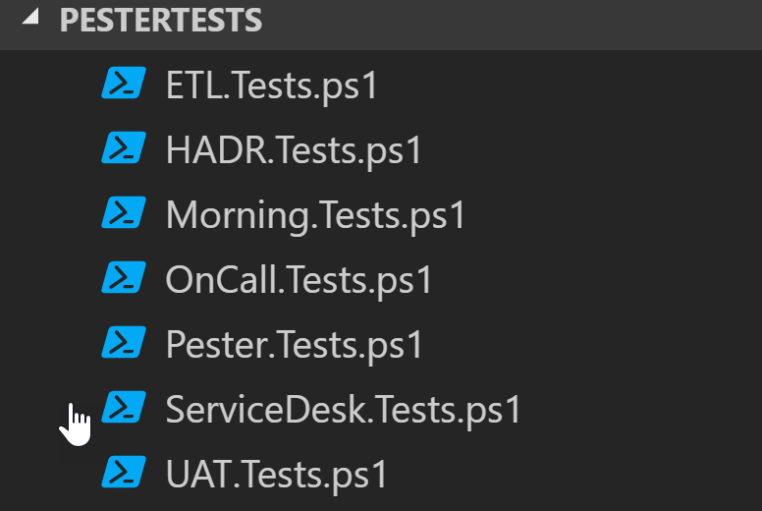
Got your own Checks?
Set-DbcConfig –Name app.checkrepos –Value ‘Path To PesterTests’

Slide 38

Hey Beardy !
MUST BE TIME FOR A DEMO

Slide 39
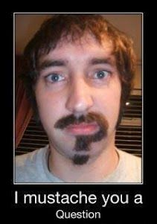
Questions?
?
?
?
?
?
?
?
?
?
?
?
?
?
?
?
?
Rob Sewell @sqldbawithbeard https://sqldbawithAbeard.com

Slide 40

Just like Jimi Hendrix …
We love to get feedback
Please complete the
session feedback forms

Slide 41
Contact Me
Quick Poll
@sqldbawithbeard
robsewellsqldba
sqldbawithAbeard.com
mrrobsewell@outlook.com
RobSewell.info

